Slide 1
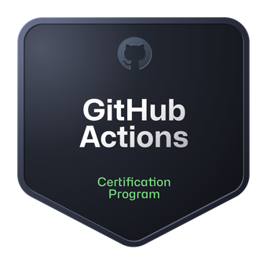
GitHub Actions Certification Crash Course
Tim Warner

Slide 2

Tim Warner
Based in Nashville, TN, US
Central Time zone
26-year MCT, 6-time MVP
My GitHub Actions badge
Contact: timw.info/linkedin

Slide 3
Agenda
Automate development tasks with GitHub Actions
Build CI workflows by using GitHub Actions
Leverage GitHub Actions to publish to GitHub Packages
Create and publish custom GitHub actions
Reference: timw.info/msla

Slide 4
Course Expectations
We'll learn by doing – at least 80 percent demo
Please review the session recording…several times!
I’m here to answer your questions – take advantage of this
Please use the Q&A panel

Slide 5
Break Schedule (Central Time UTC-6/UTC-5)
07:00am - Start - Author and maintain workflows
08:00am - 9-min break - Consume workflows
09:00am - 9-min break - Author and maintain actions
10:00am - 9-min break - Manage GitHub actions for the enterprise
11:00am - 9-min break - Certification-specific guidance
12:00pm - Finish

Slide 6
Course Materials
timw.info/actions-cert-prep

Slide 7
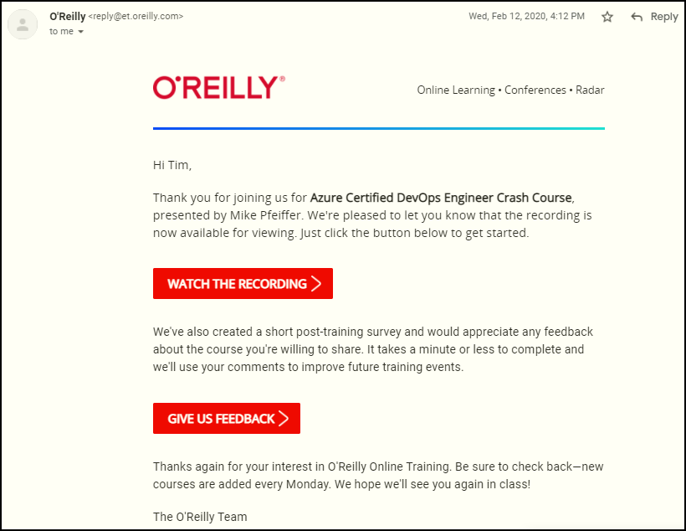
Session Recordings

Slide 8

Session Recordings

Slide 9

Session Recordings

Slide 10

Session Recordings

Slide 11


Mobile Browser: learning.oreilly.com

Slide 12



O'Reilly Mobile App

Slide 13
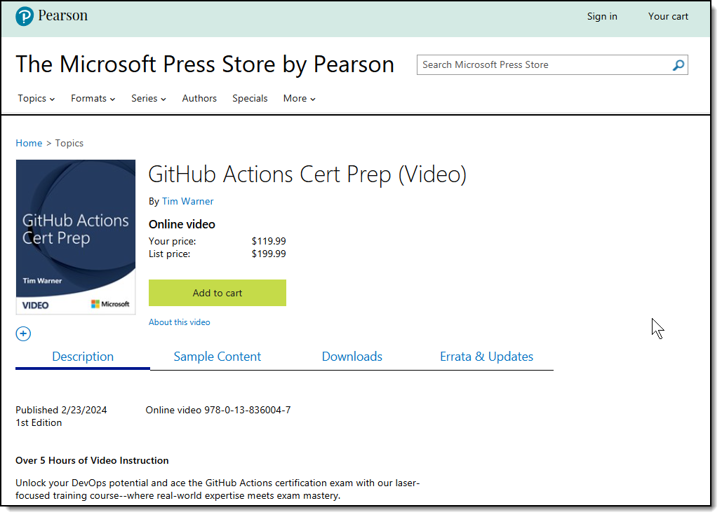
Tim's Associated Video Course

Slide 14


Slide 15

Thank you!
Course materials: timw.info/actions-cert-prep
LinkedIn: timw.info/linkedin

Slide 16
Thank You!
Course materials: timw.info/actions-cert-prep
LinkedIn: timw.info/li

Slide 17
Lesson 1: Trigger Custom Workflows
1.1 Configure workflows to run for one or more events
1.2 Configure workflows to run for scheduled events
1.3 Configure workflows to run for manual events
1.4 Configure workflows to run for webhook events
1.5 Demonstrate a GitHub event to trigger a workflow based on a practical use case

Slide 18
1.1 Configure workflows to run for one or more events

Slide 19
What is GitHub?
Collaborative developer platform
Public and private repositories
Free, Pro, Team, Enterprise
Home of GitHub Copilot (X)
Source code control
CI/CD automation
Package management
Collaboration

Slide 20
What is GitHub Actions?
Depends on the context :)
GitHub Actions refers to the entire platform and ecosystem for creating and running automated workflows within the GitHub environment
An action is a script invoked from within a workflow

Slide 21
What are workflows?
Automated scripts (actions) that run when specific events occur in your repository
Efficient way to automate development tasks
Common use cases:
CI/CD
Versioning and release management
Automation and notifications

Slide 22
GitHub workflow event types
Push events
Pull request events
Issue events
Release events
Workflow dispatch events (manual)
Scheduled events
Webhook events (external services)

Slide 23
Trigger workflow when commit is pushed
Workflow runs when a new commit is pushed to a specific branch or repository
Use cases:
Running tests after every push
Deploy code and infrastructure to staging environment

Slide 24
Example
# Workflow runs when a new commit is pushed to a specific branch or repository
# Use cases:
# Running tests after every push
# Deploy code and infrastructure to staging environment
on:
push:
branches:
- main
- develop

Slide 25
Lesson 2: Utilize Workflow Components
2.1 Identify the correct syntax for workflow jobs
2.2 Use job steps for actions and shell commands
2.3 Use conditional keywords for steps
2.4 Describe how actions, workflows, jobs, steps, runs, and the marketplace work together
2.5 Identify scenarios suited for using GitHub-hosted and self-hosted runners
2.6 Implement workflow commands as a run step to communicate with the runner
2.7 Demonstrate the use of dependent jobs

Slide 26
2.1 Identify the correct syntax for workflow jobs

Slide 27
Workflow jobs
Purpose:
Define units of work that execute specific tasks within a workflow
Elements:
jobs: Keyword to declare a job
job_name: Unique name for the job
runs-on: Target runner type (e.g., ubuntu-latest, windows-latest, self-hosted runner name)
steps: List of steps to be executed within the job

Slide 28
Workflow jobs
Workflow
Job
Step
Action

Slide 29
Example
name: Example Workflow
on:
push:
branches:
- main
jobs:
example_job: # job_name: Unique name for the job
runs-on: ubuntu-latest # Target runner type
steps: # List of steps to be executed within the job
- name: Checkout code
uses: actions/checkout@v2
- name: Execute a command
run: echo "Hello, GitHub Workflow!"

Slide 30
2.2 Use job steps for actions and shell commands

Slide 31
Job steps
Purpose:
Define individual tasks to be executed within a job
Elements:
steps: Keyword to declare steps within a job
uses: (Optional) Use a pre-built action from the GitHub Actions marketplace
action_name: Name of the action to use
version: (Optional) Specific version of the action to use
with: (Optional) Input values for the action
name: (Optional) Custom name for the step
run: Execute a shell command within the step
command_to_execute: Shell command to be executed

Slide 32
Example: job steps
name: Example Workflow for Job Steps
on:
push:
branches:
- main
jobs:
example_job:
runs-on: ubuntu-latest
steps:
- name: Checkout Repository # name: Custom name for the step
uses: actions/checkout@v2 # uses: Use a pre-built action
- name: Set up Node.js # name: Custom name for the step
uses: actions/setup-node@v2 # action_name: Name of the action to use
with: # with: Input values for the action
node-version: '14'
- name: Install Dependencies # name: Custom name for the step
run: npm install # run: Execute a shell command within the step
- name: Run Tests # name: Custom name for the step
run: npm test # command_to_execute: Shell command to be executed

Slide 33
Lesson 3: Secure Workflow Data
3.1 Use encrypted secrets to store sensitive information
3.2 Identify the available default environment variables during the construction of the workflow
3.3 Identify the location to set custom environment variables in a workflow
3.4 Identify when to use the GITHUB_TOKEN secret
3.5 Demonstrate how to use workflow commands to set environment variables

Slide 34
3.1 Use encrypted secrets to store sensitive information

Slide 35
The importance of securing data
Protecting sensitive information like passwords, access tokens, and API keys is crucial
Data breaches can have severe consequences for organizations and individuals
GitHub Actions provides several features for secure data handling

Slide 36
Use encrypted secrets
Definition: Secure storage for sensitive data like API keys
Usage: Accessible by workflows in the same repository
Setup: GitHub.com > Settings > Secrets > New repository secret

Slide 37
Example: Use encrypted secrets
name: My workflow
on: push
jobs:
build:
runs-on: ubuntu-latest
steps:
- uses: actions/checkout@v3
- name: Install dependencies
run: npm install
- name: Build the code
run: npm run build
- name: Deploy the code
run: |
# Use the value of the encrypted SECRET_KEY secret
./deploy.sh ${{ secrets.SECRET_KEY }}

Slide 38
3.2 Identify the available default environment variables during the construction of the workflow

Slide 39
Default environment variables
Definition: Pre-set variables like GITHUB_REPOSITORY
Purpose: Provide context about the current run
Usage: Referenced directly in workflow files

Slide 40
3.3 Identify the location to set custom environment variables in a workflow

Slide 41
Lesson 4: Craft Purposeful Workflows
4.1 Add a script to a workflow
4.2 Demonstrate how to publish to GitHub Packages using a workflow
4.3 Demonstrate how to publish to GitHub Container Registry using a workflow
4.4 Use database and service containers in a GitHub Actions workflow
4.5 Use labels to route workflows to specific runners
4.6 Use CodeQL as a step in a workflow
4.7 Demonstrate how to publish a component as a GitHub release using GitHub Actions
4.8 Deploy a release to a cloud provider using a GitHub Actions workflow

Slide 42
4.1 Add a script to a workflow

Slide 43
Add a script to a workflow
Execute custom scripts
Use the run keyword in your workflow file to execute any script
For example, run a script to install dependencies
Integrate scripts with workflow
Pass arguments to your script to configure its behavior
Use environment variables to access information from the workflow

Slide 44
Example: Install dependencies
name: Flask App CI
on: [push, pull_request]
jobs:
build:
runs-on: ubuntu-latest
steps:
- uses: actions/checkout@v3
- uses: actions/setup-python@v3
with: {python-version: '3.10', cache: 'pip'}
- run: |
python -m pip install --upgrade pip
pip install -r requirements.txt

Slide 45
4.2 Demonstrate how to publish to GitHub Packages using a workflow

Slide 46
Publish GitHub packages
Workflow setup
Upload package: Use the actions/upload-artifact action to upload your package
Automation: Set the workflow to trigger on push events to automatically publish on code changes
Credential configuration
Repository access: Use the actions/checkout action to access your repo and access the requirements.txt (Python) file for authentication along with PAT
Security: Use secret variables for secure credentials

Slide 47
Example: Fetch from GitHub Packages
name: Fetch GitHub Package
on: [push, pull_request]
jobs:
fetch-package:
runs-on: ubuntu-latest
steps:
- uses: actions/checkout@v3
- name: Setup Node.js
uses: actions/setup-node@v3
with:
node-version: '14'
registry-url: 'https://npm.pkg.github.com'
- name: Install package
run: npm install @your-username/your-package-name
env:
NODE_AUTH_TOKEN: ${{secrets.GITHUB_TOKEN}}

Slide 48
4.3 Demonstrate how to publish to GitHub Container Registry using a workflow

Slide 49
Lesson 5: Optimize Workflow Runs
5.1 Configure caching of workflow dependencies
5.2 Identify steps to pass data between jobs in a workflow
5.3 Remove workflow artifacts from GitHub
5.4 Add a workflow status badge
5.5 Add environment protections
5.6 Define a matrix of different job configurations
5.7 Implement workflow approval gates

Slide 50
5.1 Configure caching of workflow dependencies

Slide 51
Caching workflow dependencies
Avoid re-downloading dependencies for every job run
Cache specific paths or directories for faster execution
Use multi-level cache for nested dependencies
Set cache expiration based on file changes or workflow tags

Slide 52
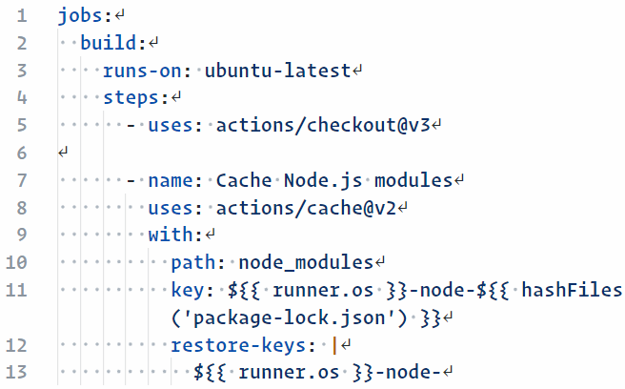
Caching workflow dependencies

Slide 53
5.2 Identify steps to pass data between jobs in a workflow

Slide 54
Pass data between workflow jobs
Share information and artifacts between jobs for efficient workflows
Define outputs from individual steps to pass data
Leverage environment variables for secrets and configuration
Manage resource usage with job concurrency limits

Slide 55
Example: Pass data between workflow jobs
jobs:
build:
runs-on: ubuntu-latest
steps:
- ... build steps ...
- name: Upload build artifacts
uses: actions/upload-artifact@v2
with:
name: application
path: build/app.zip
test:
runs-on: ubuntu-latest
needs: build
steps:
- name: Download build artifacts
uses: actions/download-artifact@v2
with:
name: application
- name: Run tests
... test steps using the downloaded application ...
Use GitHub cloud storage as a data "holding area"

Slide 56
5.3 Remove workflow artifacts from GitHub

Slide 57
Lesson 6: Analyze Workflow Effects
6.1 Identify the event that triggered a workflow from its effects in a repository, issue or pull request
6.2 Describe a workflow’s effects from reading its configuration file
6.3 Diagnose a failed workflow run
6.4 Identify ways to access the workflow logs from the user interface
6.5 Identify ways to access the workflow logs from GitHub’s REST API
6.6 Enable step debug logging in a workflow
6.7 Demonstrate how to use default environment variables in a workflow
6.8 Demonstrate the correct syntax for passing custom environment variables in a workflow step

Slide 58
6.1 Identify the event that triggered a workflow from its effects in a repository, issue or pull request

Slide 59
Event trigger identification
Review GitHub Actions logs to pinpoint the triggering event (push, pull request, issue creation, etc.)
Logs are retained for 90 days by default
Adjustable to 90d (public) and 400d (private)
Use ${{ github.event_name }} in your workflow to dynamically identify the event type
Example: Trigger workflow on push event and include logic to handle different event types

Slide 60
Event trigger identification
A GitHub Actions workflow that identifies the type of event that triggered it:
name: Identify Event Type
on: [push, pull_request, issues]
jobs:
identify-event:
runs-on: ubuntu-latest
steps:
- name: Check Event Name
run: echo "This workflow was triggered by a ${{ github.event_name }} event."

Slide 61
6.2 Describe a workflow’s effects from reading its configuration file

Slide 62
Analyzing workflow configuration
The goal is for you to understand a workflow's effects and impact without running it
Break down the .yml file to understand the workflow steps and actions used
Correlate actions in the workflow with effects (build, test, deploy, etc.)
Example: A workflow with actions/checkout and actions/upload-artifact for building and storing results

Slide 63
6.3 Diagnose a failed workflow run

Slide 64
Diagnosing workflow failures
Check error messages and exit codes in the Actions log for failure insights
Review common failure causes: syntax errors, missing secrets, external service downtime
Example: Debugging a failed build step due to missing environment variables

Slide 65
Lesson 7: Navigate Workflow Assets
7.1 Describe where to locate a workflow in a repository
7.2 Explain the difference between disabling and deleting of workflows
7.3 Demonstrate how to download workflow artifacts from the user interface
7.4 Describe how to use an organization’s templated workflow

Slide 66
7.1 Describe where to locate a workflow in a repository

Slide 67
Locating workflows
Workflows are stored in .github/workflows directory in a GitHub repository
Each workflow is defined in a separate .yml or .yaml file
Browse the repository's file structure to find and view workflow files

Slide 68
7.2 Explain the difference between disabling and deleting of workflows

Slide 69
Disabling vs. deleting workflows
Disabling a workflow
Temporarily prevents the workflow from running without deleting the file
Deleting a workflow
Permanently removes the workflow file from the repository
Disabling is useful for maintenance or testing; deleting is for workflows no longer needed

Slide 70
7.3 Demonstrate how to download workflow artifacts from the user interface

Slide 71
Generating an artifact
name: Build and Archive Artifact
on: push
jobs:
build:
runs-on: ubuntu-latest
steps:
- name: Checkout Code
uses: actions/checkout@v2
- name: Build Project
run: make build
- name: Archive Production Artifacts
uses: actions/upload-artifact@v2
with:
name: build-artifacts
path: path/to/artifacts/

Slide 72
Downloading artifacts
Artifacts are generated by a workflow run (like logs, binary files, etc.)
Navigate to Actions tab, select a workflow run, and find the Artifacts section to download
Useful for retrieving build outputs, test results, logs, etc.

Slide 73
Lesson 8: Employ Trustworthy Actions
8.1 Define the indicators of what makes a trustworthy action
8.2 Identify an action’s type, inputs, and outputs
8.3 Demonstrate how to use the specific version of an action in a workflow

Slide 74
8.1 Define the indicators of what makes a trustworthy action

Slide 75
Trustworthy action indicators
Source: Prefer actions hosted in public, reputable repositories
Maintenance: Regular updates and active issue resolution indicate good maintenance
Community Trust: High number of stars, forks, and positive feedback
Documentation: Clear, detailed documentation with examples

Slide 76
8.2 Identify an action’s type, inputs, and outputs

Slide 77
Action's type, inputs, and outputs
Type: Public vs Private, JavaScript vs Docker container actions
Inputs: Parameters passed to the action (defined in action's action.yml)
Outputs: Data that action returns after execution (also defined in action.yml)
Usage: Refer to action's documentation for understanding its inputs/outputs

Slide 78
Using an action with inputs and outputs
name: Example Workflow
on: push
jobs:
greet:
runs-on: ubuntu-latest
steps:
- name: Greeting Action
id: greet
uses: actions/hello-world-javascript-action@v1.1
with:
who-to-greet: 'World'
- name: Get the greeting time
run: echo "The time was ${{ steps.greet.outputs.time }}"

Slide 79
8.3 Demonstrate how to use the specific version of an action in a workflow

Slide 80
Specific version of an action
Always specify a specific version of an action to use (v1.2.3 or commit SHA)
Avoid using tags like master or latest to ensure reliability
Using a specific version prevents unexpected changes due to action updates

Slide 81
Lesson 9: Select Action Types
9.1 Identify the type of action required for a given problem
9.2 Demonstrate how to troubleshoot JavaScript actions
9.3 Demonstrate how to troubleshoot Docker container actions

Slide 82
9.1 Identify the type of action required for a given problem

Slide 83
Identifying action types
Understand the problem: Determine if it's a build, test, deploy, or a custom task
Choose action type: Use JavaScript actions for cross-platform tasks and quick execution
Docker actions: Prefer for tasks requiring specific environment setup or dependencies
Community actions: Explore GitHub Marketplace for existing solutions

Slide 84
Selecting an action type
name: Example - Build and Test
on: push
jobs:
build-and-test:
runs-on: ubuntu-latest
steps:
- name: Checkout Code
uses: actions/checkout@v2
- name: Setup Node (JavaScript Action)
uses: actions/setup-node@v1
- name: Build and Test (Custom Docker Action)
uses: docker://ghcr.io/username/custom-action:latest

Slide 85
9.2 Demonstrate how to troubleshoot JavaScript actions

Slide 86
Troubleshooting JavaScript actions
Check action logs for errors or unexpected behaviors
Validate action's inputs: Ensure correct and expected inputs are provided
Dependency issues: Make sure all necessary packages and versions are correctly specified
Action's code: Examine the JavaScript source code for the action (if open source)

Slide 87
Debugging a JavaScript action
name: Debug JS Action
on: push
jobs:
debug:
runs-on: ubuntu-latest
steps:
- name: Problematic Action
id: problematic
uses: actions/problematic-action@v1
with:
some-input: 'value'
# Add environment variable to enable detailed logging
env:
ACTIONS_STEP_DEBUG: true

Slide 88
9.3 Demonstrate how to troubleshoot Docker container actions

Slide 89
Lesson 10: Detail Action Components
10.1 Identify the files and directory structure needed to create an action
10.2 Identify the metadata and syntax needed to create an action
10.3 Implement workflow commands within an action to communicate with the runner, including exit codes

Slide 90
10.1 Identify the files and directory structure needed to create an action

Slide 91
Action files and structure
Main directories
src for source code
lib for compiled code (for JavaScript actions)
Required files
action.yml or action.yaml (metadata file)
README.md (documentation)
Optional files
LICENSE
.gitignore
other dependencies or configuration files

Slide 92
Example directory structure
my-action/
├── action.yml
├── README.md
├── .gitignore
├── src/
│ └── index.js
└── lib/
└── index.js
Bottom line: Follow GitHub's Marketplace submission guidelines timw.info/mkt

Slide 93
10.2 Identify the metadata and syntax needed to create an action

Slide 94
Action metadata and syntax
action.yml contents: name, description, inputs, outputs, runs
Specify runs.using for the action type (node12, docker, etc.)
Define inputs and outputs with keys and descriptions

Slide 95
action.yml for a JavaScript action
name: 'Greet Someone'
description: 'Greet someone and record the time'
inputs:
who-to-greet:
description: 'Who to greet'
required: true
default: 'World'
outputs:
time:
description: 'The time we greeted you'
runs:
using: 'node12'
main: 'dist/index.js'

Slide 96
10.3 Implement workflow commands within an action to communicate with the runner, including exit codes

Slide 97
Lesson 11: Distribute Custom Actions
11.1 Identify how to select an appropriate distribution model for an action
11.2 Identify the best practices for distributing custom actions
11.3 Demonstrate how to create a release strategy for an action
11.4 Demonstrate how to publish an action to the GitHub marketplace

Slide 98
11.1 Identify how to select an appropriate distribution model for an action

Slide 99
Distribution model selection
Repository-based distribution: Share actions within a single repository or organization
Marketplace distribution: Share publicly on GitHub Marketplace for wider accessibility
Considerations:
Frequency of updates
Visibility
Target audience

Slide 100
Repository-based action reference
name: Use Internal Action
on: push
jobs:
custom-action-job:
runs-on: ubuntu-latest
steps:
- name: Checkout
uses: actions/checkout@v2
- name: Internal Custom Action
uses: ./.github/actions/my-custom-action

Slide 101
11.2 Identify the best practices for distributing custom actions

Slide 102
Best practices for action distribution
Versioning: Use semantic versioning (e.g., v1.0.0) for clarity and stability
Documentation: Provide detailed README.md with usage instructions and examples
Licensing: Include an appropriate open-source license (e.g., MIT, Apache 2.0)

Slide 103
Semantic versioning
timothywarner/my_action@v1.2.3
1 is the major version (breaking changes)
2 is the minor version (new functionality)
3 is the patch version (backward-compatible bug fixes)
Advantage: clarity in dependency and release management

Slide 104
11.3 Demonstrate how to create a release strategy for an action

Slide 105
Lesson 12: Propagate Enterprise Actions
12.1 Explain reuse templates for actions and workflows
12.2 Define an approach for managing and leveraging reusable components
12.3 Define how to distribute actions for an enterprise
12.4 Define how to control access to actions within the enterprise
12.5 Configure organizational use policies for GitHub Actions

Slide 106
12.1 Explain reuse templates for actions and workflows

Slide 107
Reuse templates
Templates for actions and workflows: Create standardized templates for common tasks
Store in a central repository or .github repository within the organization
Reduces duplication, ensures consistency across projects

Slide 108
12.2 Define an approach for managing and leveraging reusable components

Slide 109
Managing reusable components
Centralized repository: Store reusable actions and workflows in a dedicated repo
Version control: Use tags or releases to manage versions of reusable components
Documentation: Maintain clear usage instructions and examples for each component

Slide 110
Reusable workflow template
name: Use Workflow Template
on: push
jobs:
build:
uses: organization/.github/.github/workflows/build-template.yml

Slide 111
Reusable action reference
name: Use Reusable Action
on: push
jobs:
greet:
runs-on: ubuntu-latest
steps:
- name: Reusable Greeting Action
uses: organization/reusable-actions/greeting@v1

Slide 112
Caching
Storing frequently accessed files (like dependencies or build outputs) in GitHub's cloud for faster access
Advantages:
Faster build times
Reduced bandwidth and resource usage
Improved stability and reliability
Consistent build environments
Cost efficiency

Slide 113
Lesson 13: Administer Enterprise Runners
13.1 Describe the effects of configuring IP allow lists on GitHub-hosted and self-hosted runners
13.2 Describe how to select appropriate runners to support workloads
13.3 Explain the difference between GitHub-hosted and self-hosted runners
13.4 Configure self-hosted runners for enterprise use
13.5 Demonstrate how to manage self-hosted runners using groups
13.6 Demonstrate how to monitor, troubleshoot, and update self-hosted runners

Slide 114
13.1 Describe the effects of configuring IP allow lists on GitHub-hosted and self-hosted runners

Slide 115
Allow lists and runners
IP allow lists on GitHub-hosted runners: Controls which external services the runners can interact with
Self-hosted runners: IP allow lists can restrict inbound connections for enhanced security
Impact: Ensures network-level security but may require adjustments for specific integrations

Slide 116
13.2 Describe how to select appropriate runners to support workloads

Slide 117
Choosing runners for workloads
Consider workload requirements: OS, memory, CPU, and specific software
GitHub-hosted runners: Offer various environments, easy to use but with usage limits
Self-hosted runners: More control over the environment, suitable for specific needs

Slide 118
Specifying runner type
name: Example Workflow
on: push
jobs:
build:
runs-on: self-hosted # or ubuntu-latest for GitHub-hosted
steps:
- name: Checkout
uses: actions/checkout@v2
- name: Build
run: make build

Slide 119
13.3 Explain the difference between GitHub-hosted and self-hosted runners

Slide 120
GitHub-hosted vs. self-hosted runners
GitHub-hosted runners: Managed by GitHub, limited customization, quick setup
Self-hosted runners: Full control over the environment, better for sensitive data
Use case: Choose based on security needs, customization, and available resources

Slide 121
Lesson 14: Guard Enterprise Secrets
14.1 Identify the scope of encrypted secrets
14.2 Demonstrate how to access encrypted secrets within actions and workflows
14.3 Explain how to manage organization-level encrypted secrets
14.4 Explain how to manage repository-level encrypted secrets

Slide 122
14.1 Identify the scope of encrypted secrets

Slide 123
Scope of encrypted secrets
Secrets can be scoped at the repository or organization level
Repository secrets are only accessible to actions running in that repository
Organization secrets can be shared across multiple repositories within the org

Slide 124
14.2 Demonstrate how to access encrypted secrets within actions and workflows

Slide 125
Accessing encrypted secrets
Secrets are accessed in workflows using the secrets context
Use ${{ secrets.SECRET_NAME }} syntax to refer to a secret
Same context regardless of where the secret exists
Secrets are masked in logs and are not exposed to users

Slide 126
Accessing a secret
jobs:
example_job:
runs-on: ubuntu-latest
steps:
- name: Echo a secret
run: echo "The secret is ${{ secrets.MY_SECRET }}"
---
run echo "The secret is ***"
The secret is ***
Padding is optional
Plaintext is never exposed in console and logs

Slide 127
14.3 Explain how to manage organization-level encrypted secrets

Slide 128
Organization-level secrets
Set secrets at the organization level for cross-repository access
Configure access permissions to restrict which repositories can use the secret
Ideal for secrets like deployment credentials used across multiple projects

